Slide 1
Educational Game for VR
Developed and Presented by Donald Brant, Alan Lam, & Jose Romero

Slide 2
Project Goals
Develop directed VR educational minigames to teach life skills such as cooking and car maintenance
Provide a simple method for reviewing flashcards in VR

Slide 3
Implemented Flashcard Features
Easy input method for users to create custom flashcards (.csv)
Dynamic ‘Omnicard’ display
Input to allow the user to move onto the next card

Slide 4
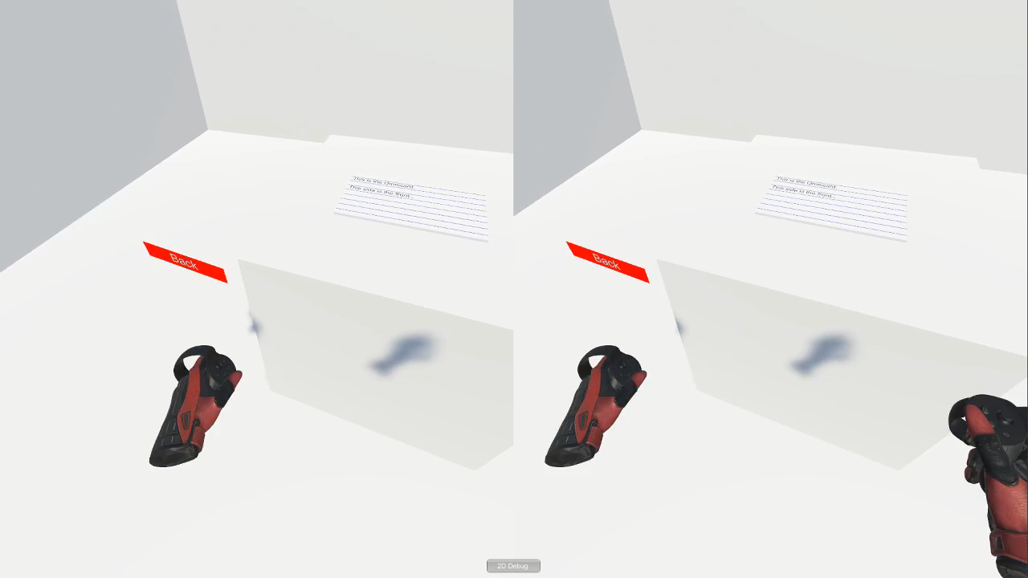

Slide 5
Upcoming Flashcard Features
Card shuffling
Allowing users to mark cards as ‘learned’
Built in flashcard sets associated with the other levels of the game

